Slide 1
Clustering: How-to and Applications
John Monroe
10/26/18

Slide 2
Clustering Objective
Complex Data
Clustering
Simple conclusion
Biology
Rich bacterial variability
Taxonomic classification
Machine Learning
Haphazardly collected data
Meaningful patterns
General Science
Many degrees of freedom
Essential underlying parameters

Slide 3
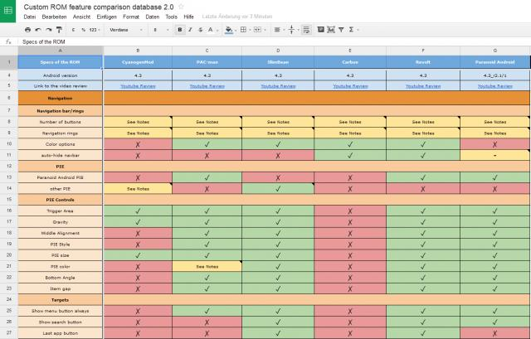
Basic Ingredients
1. Data
Spatial Information
Shopping habits
Sequences
Similarity sets are not always immediately obvious
High dimensional data is hard to visualize
Data comes in many different forms
The Verge 2018/2/9/16994638

Slide 4
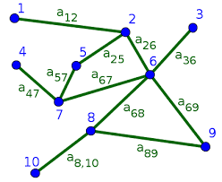
Basic Ingredients
2. Distance Measure
Spatial Information
Shopping habits
Sequences
+
+
+
Euclidean Distance
Similarity graph
Genome counts
Distance measures are generally applicable to many datasets.
ncbi.nlm.nih.gov/Structure/cdd

Slide 5
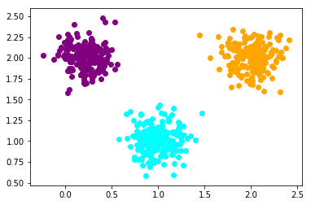
The k-means Algorithm
The goal:
(0.4, 1.82)
(1.0, 0.75)
(2.1, 2.05)
…
N data points
k clusters
The data:
X2
X1

Slide 6
The k-means Algorithm
The algorithm:
> Initialize random cluster indices
> Repeat until convergence:
> For each data point:
> Distance( point, centerj )
> new_index ← minj(distance)
> total_distance += distance
The data:
X2
X1

Slide 7
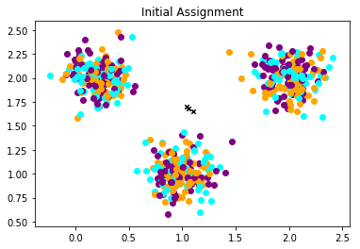
The k-means Algorithm
The algorithm:
> Initialize random cluster indices
> Repeat until convergence:
> For each data point:
> Distance( point, centerj )
> new_index ← minj(distance)
> total_distance += distance
The data:
X2
x
x
x
X1

Slide 8
The k-means Algorithm
The algorithm:
> Initialize random cluster indices
> Repeat until convergence:
> For each data point:
> Distance( point, centerj )
> new_index ← minj(distance)
> total_distance += distance
The data:
X2
x
x
x
X1

Slide 9
The k-means Algorithm
The algorithm:
> Initialize random cluster indices
> Repeat until convergence:
> For each data point:
> Distance( point, centerj )
> new_index ← minj(distance)
> total_distance += distance
The data:
X2
x
x
x
X1

Slide 10
The k-means Algorithm
The algorithm:
> Initialize random cluster indices
> Repeat until convergence:
> For each data point:
> Distance( point, centerj )
> new_index ← minj(distance)
> total_distance += distance
The data:
X2
x
x
x
X1

Slide 11
The k-means Algorithm
The algorithm:
> Initialize random cluster indices
> Repeat until convergence:
> For each data point:
> Distance( point, centerj )
> new_index ← minj(distance)
> total_distance += distance
The data:
X2
x
x
x
X1

Slide 12
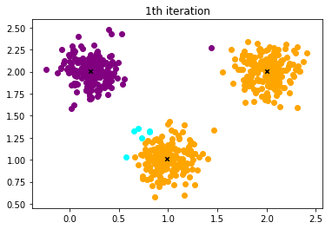
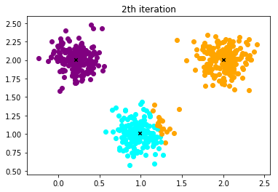


The k-means Algorithm
The algorithm:
> Initialize random cluster indices
> Repeat until convergence:
> For each data point:
> Distance( point, centerj )
> new_index ← minj(distance)
> total_distance += distance
The data:
X2
x
x
x
x
x
X1

Slide 13
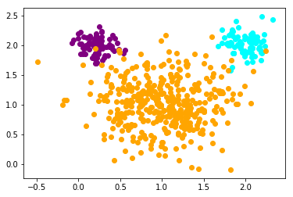
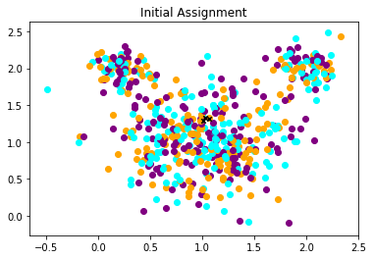
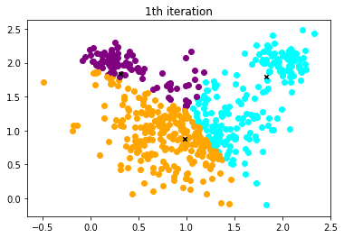
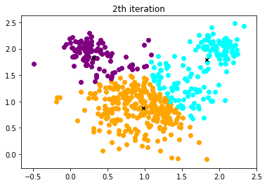
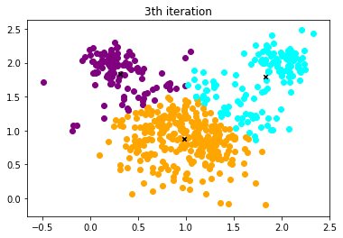
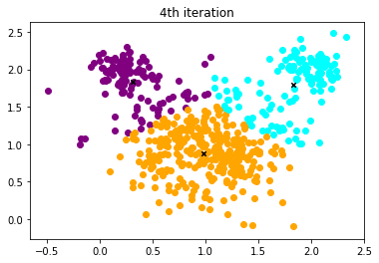
Problems with k-means
Previous data:
New data:
X2
X2
X1
X1
Poor fits to dissimilar clusters
X2
Solution:
Soft k-means
X1

Slide 14
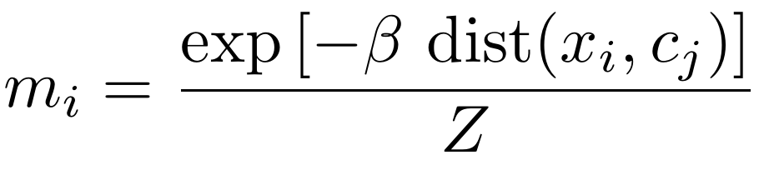
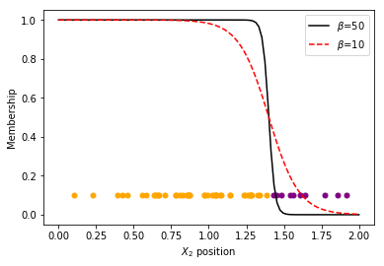
Soft k-means Algorithm
Hard k-means:
> new_index ← minj(distance)
Soft k-means:
> membership ← mj(distance)
X2
Membership
X1
X2

Slide 15
Soft k-means Algorithm
Utilizes full posterior distribution rather than the approximate MLE
Recall the urn problem:
…
u=0
u=1
u=2
u=10
N=10 draws
…
Cluster = urn 3
P(u)
Cluster distribution
u

Slide 16
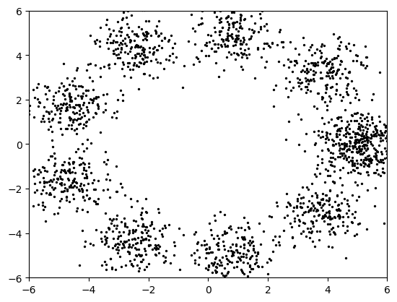
Another Problem: Choosing k
X2
X2
X1
X1
k is “obvious”
What is k?
Few clusters
Many clusters
Compression
Accuracy
Recall hypothesis comparison with many parameters

Slide 17
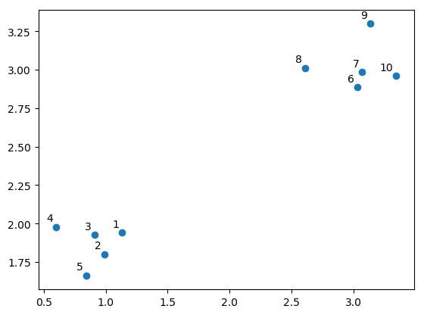
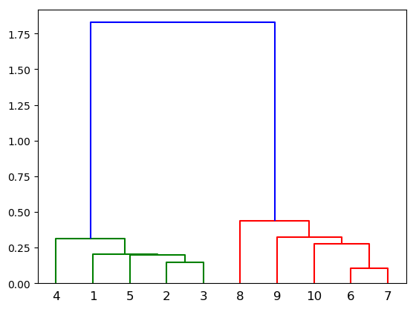
Dendrogram
X2
Distance threshold
k=10
X1
Point label

Slide 18
Dendrogram
X2
Distance threshold
k=8
k=10
X1
Point label

Slide 19
Dendrogram
k=2
X2
Distance threshold
k=8
k=10
X1
Point label
Definite criteria for k:
Choose maximum change in distance threshold
Hypothesis comparison:
Allow the data to speak for itself

Slide 20
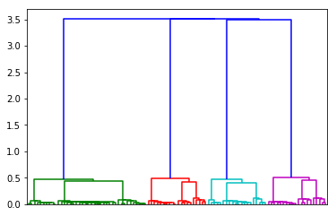
No Silver Bullet
X2
Distance threshold
X1
Point label
Which threshold is “correct?”
k=4?
k=12?
The question is not “which k should I choose?”
but rather “how is my data structured?”

Slide 21
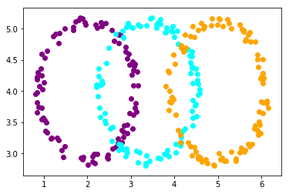
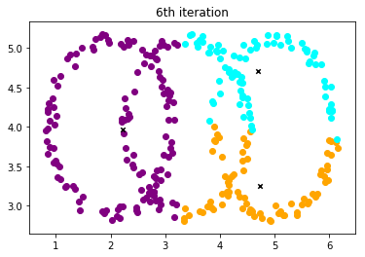
Yet More Problems
Some data is very difficult to cluster
X2
X2
X1
X1
Clustering is not a silver bullet to grouping data.

Slide 22
Takeaways
Clustering is a valuable tool for dimensional reduction.
Modified k-means is a good tool for clustering.
Clustering strategy is ultimately sensitive to data’s structure.

